Slide 2
BlogWave: Empowering Content Creation
This presentation introduces BlogWave, a robust backend infrastructure for a modern blog platform. It covers team members, project description, learning objectives, technologies used, third-party services, key features and challenges, project timeline, API endpoints, and the conclusion. It aims to empower users to create, manage, and share their content seamlessly with a scalable, secure, and feature-rich backend that supports a user-friendly frontend interface.

Slide 3
BlogWave: Empowering Content Creation
Content Creation

Slide 4

Team Member
Johanne Essiere

Slide 5
Project Description
BlogWave is a robust backend infrastructure for a modern blog platform. It empowers users to create, manage, and share their content seamlessly. Our focus is on building a scalable, secure, and feature-rich backend that will support a user-friendly frontend interface.

Slide 6

Learning Objectives
Master Node.js and Express.js for serverside development.
Gain proficiency in MongoDB for efficient data management.
Implement secure user authentication and authorization.
Develop RESTful APIs for seamless frontendbackend communication.
Learn best practices for scalable and maintainable backend architecture.

Slide 7
Technologies Used
Node.js
Express.js
MongoDB
JSON Web Tokens (JWT) for authentication
Mongoose ODM

Slide 8
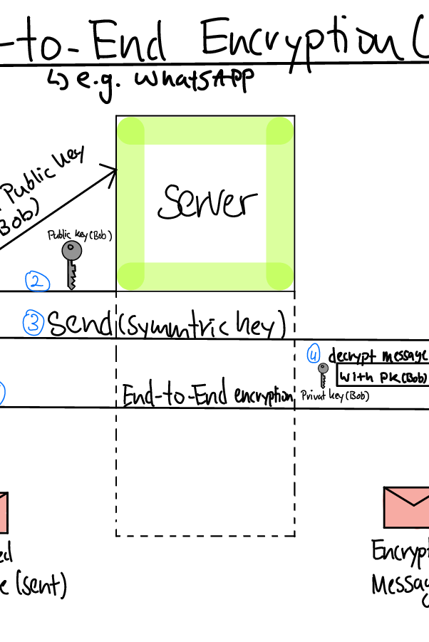
Third-Party Services
MongoDB Atlas for cloud database hosting
AWS S3 (for image upload functionality, if time permits)

Slide 9
Key Features and Challenges
User Authentication System Challenge: Implementing secure login/signup with JWT
CRUD Operations for Blog Posts Challenge: Efficient data modeling and query optimization
User Reading History Challenge: Tracking and managing user interactions
Markdown Processing Challenge: Server-side markdown parsing and storage
Image Upload (Bonus) Challenge: Handling and storing image files securely

Slide 10

Project Timeline (27 days)
Week 1-2: Set up project structure and environment, implement user authentication and CRUD APIs for blog posts, create data models and database schema
Week 3: Implement user reading history functionality, develop markdown processing on the server, begin image upload functionality (if time allows)
Week 4: Finalize all API endpoints, implement error handling and logging, optimize database queries, conduct thorough testing and bug fixing, prepare documentation and API guides

Slide 11
API Endpoints (Preview)
The following are some of the API Endpoints:

Slide 12
POST /api/auth/signup
POST /api/auth/login
GET /api/posts
POST /api/posts
PUT /api/posts/:id
DELETE /api/posts/:id
GET /api/users/:id/readinghistory

Slide 13
Conclusion
BlogWave's backend will provide a solid foundation for a feature-rich blog platform. By focusing on scalability, security, and essential blogging features, we aim to create a backend that can support a wide range of frontend applications and user needs.

Slide 14
Thank you. Please feel free to ask any questions. 😄

